Slide 1

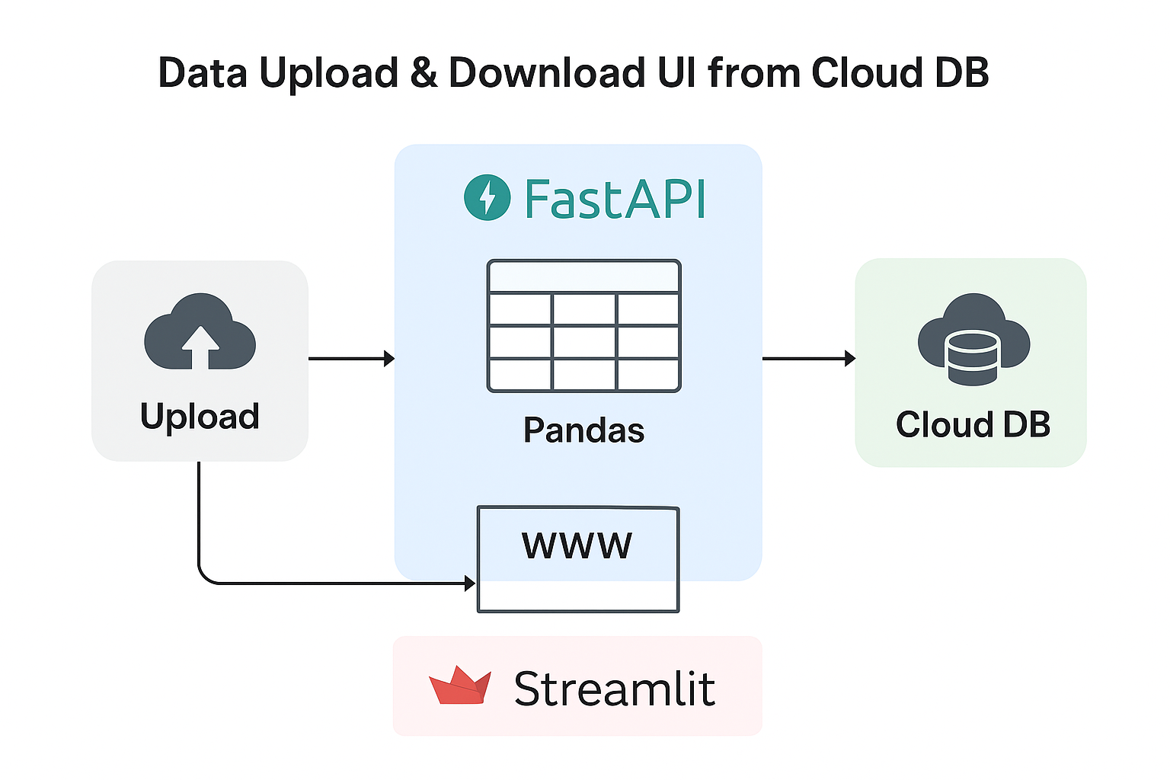
Intelligence digitalized
UI + API + AI + BI + PY + SQL Project(s)

Slide 2
Streamlit (Frontend)
Streamlit is an open-source Python framework that allows developers to build interactive, data-driven web applications with minimal code.
Why Streamlit?
Super fast app development – turn Python scripts into web apps in minutes
Zero HTML/CSS/JS needed – purely Python
Perfect for Data Engineering & AI demos
Built-in widgets like buttons, sliders, dropdowns
Works great with Pandas, NumPy, Matplotlib, ML models
Streamlit Components?
UI Components → charts, tables, images, widgets
Data Visualization → Matplotlib, Plotly, Altair
Integrations → SQL, APIs, cloud storage, ML models
Real-time interaction with Python backend
Deploy anywhere → Streamlit Cloud, GCP, Azure, AWS
Installation & Configuration (My First UI)
Install Streamlit
python -m pip install streamlit
Store the below in your user directory of windows/mac (C:\users\moham\streamlit_ui.py)
import streamlit as st
st.title("Hello Streamlit!")
In the command prompt, run the below streamlit start command
python -m streamlit run streamlit_ui.py

Slide 3
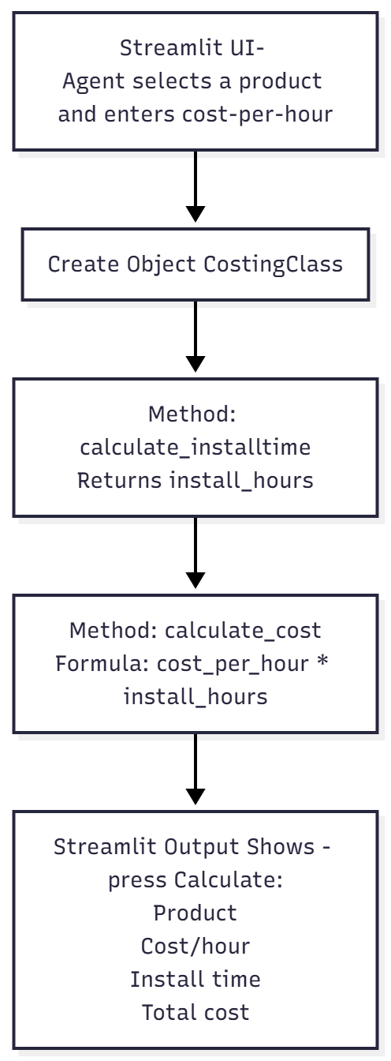
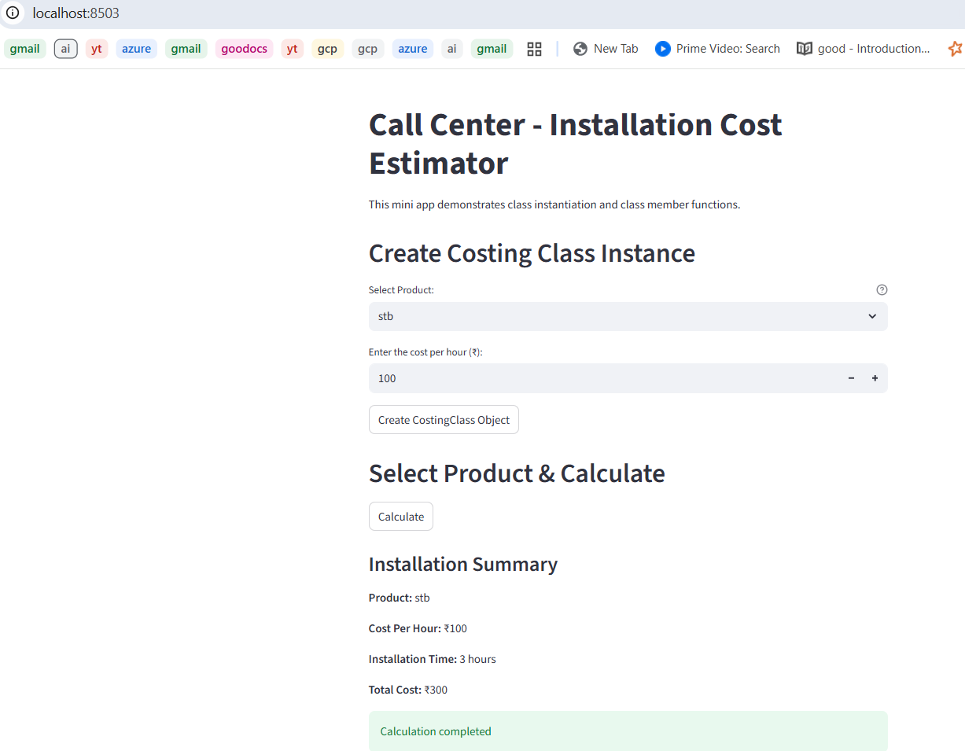
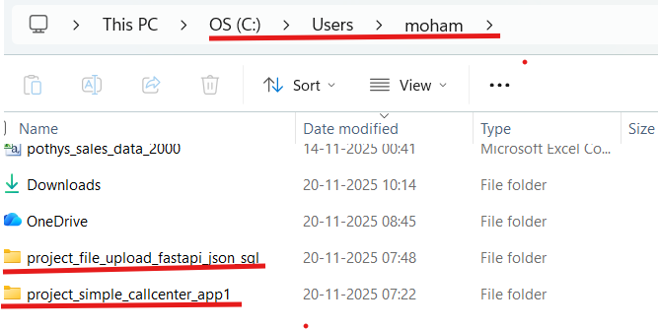
Project1 - Call Center - Installation Cost Estimator (2tier app – FE + BE)
Tier1
flowchart TD
A[Streamlit UI-
Agent selects a product and enters cost-per-hour] --> B
B[Create Object CostingClass]--> C
C[Method: calculate_installtime
Returns install_hours] --> D
D[Method: calculate_cost
Formula: cost_per_hour * install_hours] --> E
E[Streamlit Output Shows - press Calculate:
Product
Cost/hour
Install time
Total cost]
Tier2
Tier1
Open Command prompt and just run it:
python -m streamlit run project_simple_callcenter_app1\frontend\streamlit_callcenter_app.py

Slide 4
API (Middleware)
Bigquery
Console
API Service
Storage Disk
Colossus
What is an API?
An API (Application Programming Interface) is a way for two systems to communicate.
FastAPI – The Fastest Python Framework for Building APIs FastAPI is a modern, high-performance web framework for building APIs using Python. It is designed for speed, ease of use, and production-grade applications.
FastAPI is used widely for:
Real-time data pipelines
Microservices
AI/ML model serving
ETL orchestrators
Streamlit ↔ Backend communication
Installation & Configuration (My First API)
Install fastapi and uvicorn
python –m pip install fastapi uvicorn
Store the below in your user directory of windows/mac (C:\users\moham\fastapi_app.py)
from fastapi import FastAPI
app = FastAPI()
@app.get("/")
def home():
return {"message": "Hello from FastAPI!"}
In the command prompt, run the below fastapi start command
python -m uvicorn fastapi_app:app
http://127.0.0.1:8000/
Type | Meaning
GET | Fetch data from the server
POST | Send data to the server
PUT | Update existing data
DELETE | Remove data

Slide 5
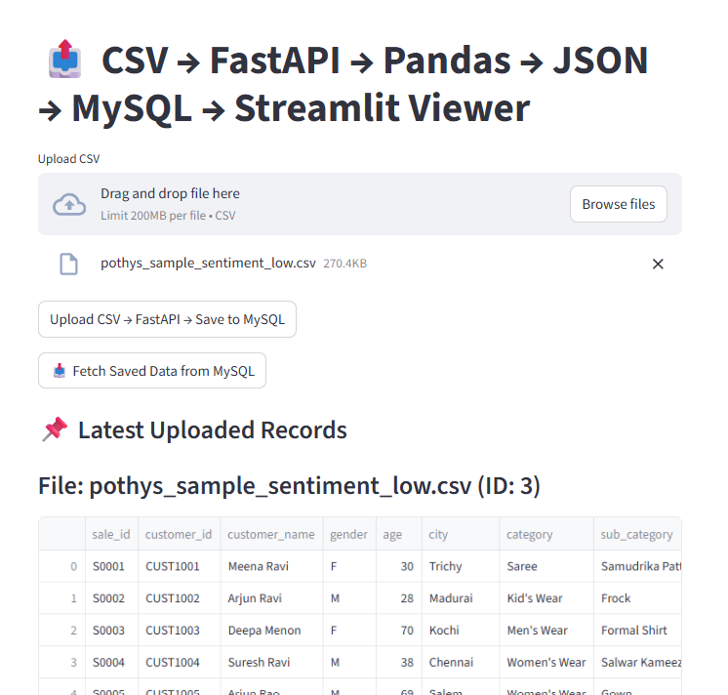
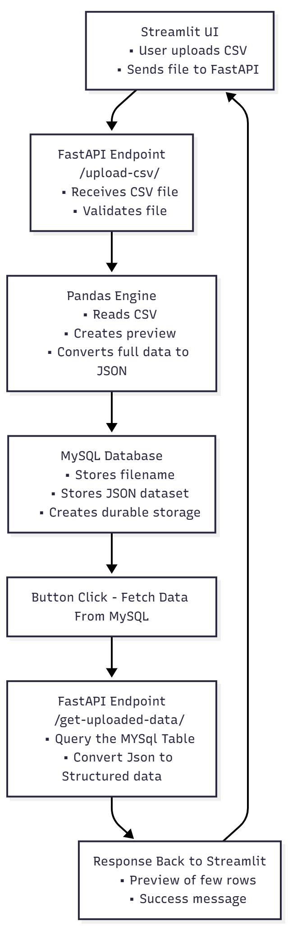
Project2 – (Streamlit (FrontEnd) + FastAPI(Middleware) + DB (Backend)) Call Center - Installation Cost Estimator
FE - Tier1
---
config:
look: neo
theme: mc
---
flowchart TD
A[Streamlit UI
• User uploads CSV
• Sends file to FastAPI] --> B
B[FastAPI Endpoint
/upload-csv/
• Receives CSV file
• Validates file] --> C
C[Pandas Engine
• Reads CSV
• Creates preview
• Converts full data to JSON] --> D
D[MySQL Database
• Stores filename
• Stores JSON dataset
• Creates durable storage] --> E
E[Response Back to Streamlit
• Preview of first rows
• Success message] --> A
MW – Tier2
BE – Tier3
BE – Tier3
FE - Tier1

Slide 6
Project2 – (Streamlit + Python) Call Center - Installation Cost Estimator
Setting up the Backend DB + Pandas + Python
CREATE TABLE uploaded_data_json (
id INT AUTO_INCREMENT PRIMARY KEY,
filename VARCHAR(200),
uploaded_at TIMESTAMP DEFAULT CURRENT_TIMESTAMP,
data LONGTEXT);
Install & Configure the fastapi
python -m pip install fastapi
python -m pip install uvicorn
Extract the code given inside your home directory:
Starting the Middleware Service (API Service) - FastAPI
python -m uvicorn project_file_upload_fastapi_json_sql.middleware_backend.fastapi_pandas_json_mysql:app
Starting the Frontend - Streamlit
python -m streamlit run project_file_upload_fastapi_json_sql\frontend\streamlit_ui.py

